Slide 1




Introduction to AngularJS
A super-heroic JavaScript Framework

Slide 2
Table of Contents
What, why, who and how?
Resources
Hello World application
Where to start
Modules and ngApp

Slide 3

What, why, who and how?

Slide 4
What, why, who and how?
MV*-based JavaScript framework
Model – represents data
View – represents information to the user
* - can be controller, presenter, view model

Slide 5
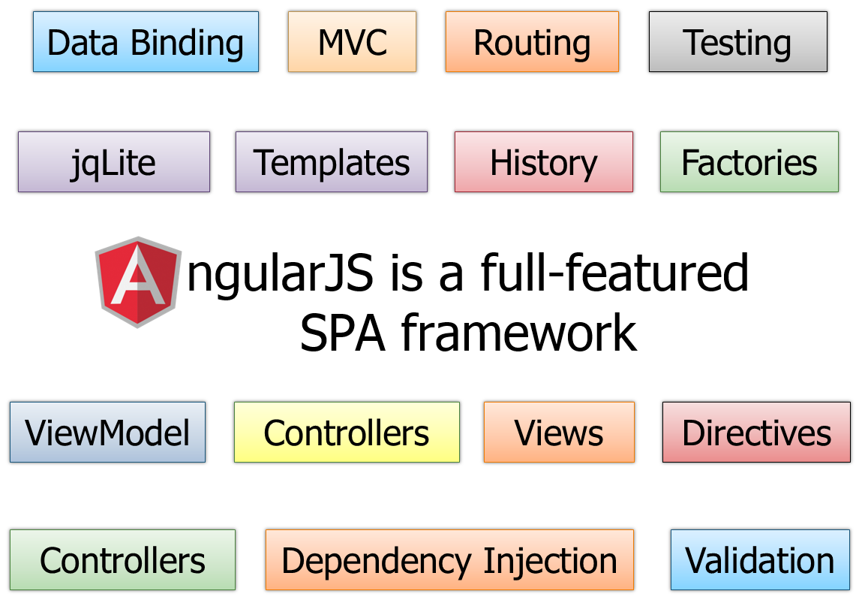
What, why, who and how?
Angular JS features:
MV*
Open Source
Comprehensive
Testable
Extends HTML
Forward Thinking

Slide 6


What, why, who and how?
Angular JS architecture:
Two-way binding
Dirty checking
Dependency injection
Angular components
Services
Controllers
Views / Directives

Slide 7

Resources

Slide 8
Resources
http://angularjs.org/
http://docs.angularjs.org/api
https://github.com/jmcunningham/AngularJS-Learning
http://fastandfluid.com/publicdownloads/AngularJSIn60MinutesIsh_DanWahlin_May2013.pdf
https://www.youtube.com/watch?v=i9MHigUZKEM

Slide 9
Hello World Application
Live Demo

Slide 10

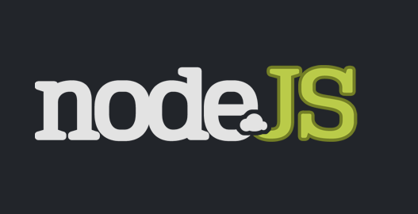

Tools
We can use:
AngularJS (latest stable version)
WebStorm or Visual Studio (or any IDE)
VS Intellisense: AngularJS.Intellisense
ASP.NET or NodeJS (server-side technology)

Slide 11
Angular Seed
What is Angular Seed:
Official starting point template
Works for small startup applications
It has good organization and architecture
Comes with basic server (NodeJS)
Get it from: https://github.com/angular/angular-seed

Slide 12

Modules and ngApp

Slide 13
Angular Modules and ngApp
Modules
Like different applications
Used only where needed in the HTML
// JavaScript
var myApp = angular.module('myApp', ['dep_1', 'dep_2']);
// HTML
<div ng-app="myApp">
<div ng-controller="myController">
<h1>{{header}}</h1>
</div>
</div>

Slide 14
AngularJS
http://academy.telerik.com

